Slide 1
Data Mining:
Concepts and Techniques
— Chapter 2 —
Jiawei Han, Micheline Kamber, and Jian Pei
University of Illinois at Urbana-Champaign
Simon Fraser University
©2011 Han, Kamber, and Pei. All rights reserved.

Slide 2
Chapter 2: Getting to Know Your Data
Data Objects and Attribute Types
Basic Statistical Descriptions of Data
Data Visualization
Measuring Data Similarity and Dissimilarity
Summary

Slide 3
Data Objects
Data sets are made up of data objects.
A data object represents an entity.
Examples:
  sales database: customers, store items, sales
  medical database: patients, treatments
  university database: students, professors, courses
Also called samples , examples, instances, data points, objects, tuples.
Data objects are described by attributes.
Database rows -> data objects; columns ->attributes.

Slide 4
Attributes
Attribute (or dimensions, features, variables): a data field, representing a characteristic or feature of a data object.
  E.g., customer _ID, name, address
Types:
  Nominal
  Binary
  Numeric: quantitative
    Interval-scaled
    Ratio-scaled

Slide 5
Attribute Types
Nominal (categorical): categories, states, or “names of things”
  Hair_color = {black, blondস্বর্ণকেশী, brown, grey, red, white}
  marital status, occupation, ID numbers, zip codes
  Each value represents some kind of category, code, or state
  The values do not have any meaningful order.
  In computer science, the values are also known as enumerations
  Because nominal attribute values do not have any meaningful order about them and are not quantitative, it makes no sense to find the mean (average) value or median (middle) value for such an attribute, given a set of objects.
  One thing that is of interest, however, is the attribute’s most commonly occurring value. This value, known as the mode, is one of the measures of central tendency.

Slide 6
Attribute Types
Binary
  Nominal attribute with only 2 states (0 and 1)
  0 typically means that the attribute is absent, and 1 means that it is present.
  Binary attributes are referred to as Boolean if the two states correspond to true and false.
  Given the attribute smoker describing a patient object, 1 indicates that the patient smokes, while 0 indicates that the patient does not
  patient undergoes a medical test that has two possible outcomes.
  The attribute medical test is binary, where a value of 1 means the result of the test for the patient is positive, while 0 means the result is negative

Slide 7
Attribute Types
  Symmetric binary: both outcomes equally important
    e.g., gender
  Asymmetric binary: outcomes not equally important.
    e.g., medical test (positive vs. negative)
    Convention: assign 1 to most important outcome (e.g., HIV positive)
Ordinal
  Values have a meaningful order (ranking) but magnitude between successive values is not known.
  Size = {small, medium, large}, grades, army rankings
  The values have a meaningful sequence (which corresponds to increasing drink size); however, we cannot tell from the values how much bigger, say, a medium is than a large.

Slide 8
Ordinal Attribute
Ordinal attributes are useful for registering subjective assessments of qualities that cannot be measured objectively;
thus ordinal attributes are often used in surveys for ratings.
In one survey, participants were asked to rate how satisfied they were as customers.
Customer satisfaction had the following ordinal categories: 0: very dissatisfied, 1: somewhat dissatisfied, 2: neutral, 3: satisfied, and 4: very satisfied.
The central tendency of an ordinal attribute can be represented by its mode and its median (the middle value in an ordered sequence), but the mean cannot be defined.

Slide 9
Ordinal Attribute
nominal, binary, and ordinal attributes are qualitative
they describe a feature of an object without giving an actual size or quantity.
The values of such qualitative attributes are typically words representing categories.
If integers are used, they represent computer codes for the categories, as opposed to measurable quantities
  (e.g., 0 for small drink size, 1 for medium, and 2 for large)

Slide 10
Numeric Attribute Types
A numeric attribute is quantitative
it is a measurable quantity, represented in integer or real values
Numeric attributes can be interval-scaled or ratio-scaled.
Interval
    Measured on a scale of equal-sized units
    Values have order
      E.g., temperature in C˚or F˚, calendar dates
    No true zero-point
Ratio
    Inherent zero-point
    We can speak of values as being an order of magnitude larger than the unit of measurement (10 K˚ is twice as high as 5 K˚).
      e.g., temperature in Kelvin, length, counts, monetary quantities

Slide 11
Discrete vs. Continuous Attributes
Discrete Attribute
  Has only a finite or countably infinite set of values
    E.g., zip codes, profession, or the set of words in a collection of documents
    উদাহরণ: জিপ কোড (যেমন: ১২০৭, ১০০০), মানুষের পেশা (যেমন: শিক্ষক, প্রকৌশলী), অথবা একটি ডকুমেন্টে থাকা মোট শব্দের সংখ্যা।
  Sometimes, represented as integer variables
  Note: Binary attributes are a special case of discrete attributes
Continuous Attribute
  Has real numbers as attribute values
    E.g., temperature, height, or weight
    উদাহরণ: তাপমাত্রা (যেমন: ৩৭.৫°C), মানুষের উচ্চতা (যেমন: ৫.৮ ফুট), অথবা কোনো বস্তুর ওজন (যেমন: ৬৫.২৫ কেজি)।
  Practically, real values can only be measured and represented using a finite number of digits
  Continuous attributes are typically represented as floating-point variables

Slide 12
Chapter 2: Getting to Know Your Data
Data Objects and Attribute Types
Basic Statistical Descriptions of Data
Data Visualization
Measuring Data Similarity and Dissimilarity
Summary

Slide 13
Basic Statistical Descriptions of Data
For data preprocessing to be successful, it is essential to have an overall picture of your data.
    উদাহরণ: একটি ক্লাসের শিক্ষার্থীদের পরীক্ষার নম্বরের ডেটাসেট নিয়ে কাজ করছ। ডেটা প্রসেস করার আগে যদি জানতে পার যে ক্লাসের গড় নম্বর ৭০, সর্বনিম্ন নম্বর ১৫ এবং সর্বোচ্চ নম্বর ৯৮—তাহলে পুরো ক্লাসের পারফরম্যান্স সম্পর্কে মাথায় একটি স্পষ্ট চিত্র তৈরি হবে।
Basic statistical descriptions can be used to identify properties of the data and highlight which data values should be treated as noise or outliers.
    উদাহরণ: আউটলায়ার (Outlier): ধরুন, একটি অফিসের কর্মচারীদের মাসিক বেতন সাধারণত ৩০,০০০ থেকে ৮০,০০০ টাকার মধ্যে। কিন্তু ওই ডেটায় কোম্পানির মালিকের বেতনও অন্তর্ভুক্ত আছে, যা মাসে ১০,০০,০০০ টাকা। এই ১০ লাখ টাকার মানটি হলো একটি 'আউটলায়ার', কারণ এটি বাকি ডেটার তুলনায় অস্বাভাবিক বড়।
    নয়েজ (Noise): ডেটা এন্ট্রি করার সময় কেউ ভুল করে কোনো কর্মচারীর বেতন
    -৫০০০ টাকা বা "নিল" লিখে রাখল। এই ধরণের ভুল বা অর্থহীন মানগুলোকে 'নয়েজ' বলা হয়।

Slide 14
Measuring the Central Tendency
Measuring the Central Tendency means finding a single value that best represents the center or "typical" value of a dataset.
It gives us an idea of the general trend of the data.

Slide 15
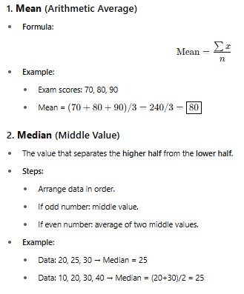
Measuring the Central Tendency

Slide 16
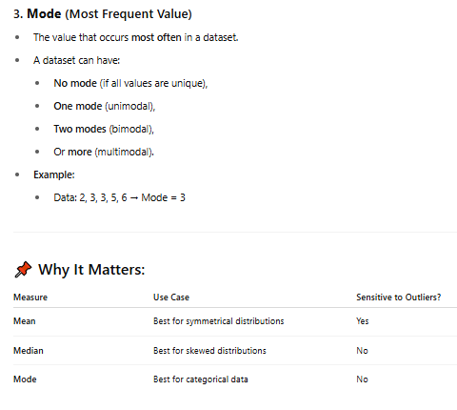
Measuring the Central Tendency
No mode (কোনো প্রচুরক নেই): যদি ডেটাসেটের প্রতিটি মান কেবল একবার করেই থাকে (অর্থাৎ কোনো মান রিপিট না হয়)।
  উদাহরণ: ১, ২, ৩, ৪, ৫ (এখানে কোনো Mode নেই)।
One mode / Unimodal (এক-প্রচুরক): যখন ডেটাসেটে কেবল একটি মানই সবচেয়ে বেশিবার থাকে।
  উদাহরণ: ১০, ২০, ২০, ৩০, ৪০ (এখানে Mode হলো ২০)।
Two modes / Bimodal (দ্বি-প্রচুরক): যখন দুটি ভিন্ন মান সমান সংখ্যায় সবচেয়ে বেশিবার থাকে।
  উদাহরণ: ৫, ৫, ৭, ৮, ৮, ৯ (এখানে ৫ এবং ৮ উভয়ই দুইবার করে আছে, তাই Mode হলো ৫ এবং ৮)।
Or more / Multimodal (বহু-প্রচুরক): যখন তিন বা তার বেশি মান সমান সংখ্যায় সবচেয়ে বেশিবার থাকে।

Slide 17
Measuring the Central Tendency: Why It Matters
The table at the bottom of the image shows which measure among Mean, Median, and Mode is most suitable for different situations and how they are affected by outliers (unusually large or small values):
A) Mean
  Use Case: Best for symmetrical distributions.
  Sensitive to Outliers?: Yes. An unusually large or small value in the data can completely distort the mean.
  Example: The monthly incomes of 5 people are 10,000, 12,000, 15,000, 13,000, and 200,000 taka. Here, 200,000 is an outlier. It pulls the mean income much higher, failing to reflect the real financial picture of the other 4 people.

Slide 18
Measuring the Central Tendency: Why It Matters
B) Median
  Use Case: Best for skewed distributions (data that leans to one side).
  Sensitive to Outliers?: No. Outliers do not change the middle value.
  Example: If you arrange the income dataset above in numerical order, the middle value (Median) is 13,000 taka. Even with the 200,000 taka outlier present, the median still gives a realistic idea of a typical person's income.

Slide 19
Measuring the Central Tendency: Why It Matters
C) Mode
  Use Case: Best for categorical data (data sorted by names or characteristics rather than numbers).
  Sensitive to Outliers?: No.
  Example: A shoe store sells 5 pairs of shoes in one day: size 7, size 8, size 8, size 8, and size 10. Since size 8 sold the most, the Mode is 8. Even if the store suddenly sells a size 12 shoe (an outlier), the most popular shoe size (Mode) remains 8.

Slide 20
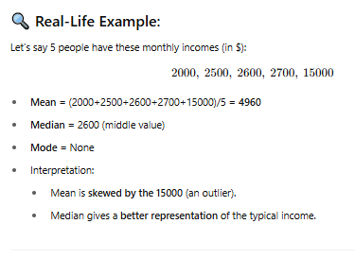
Measuring the Central Tendency

Slide 21
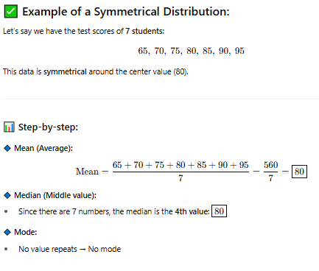
An example that shows why mean is best for symmetrical distributions:
Why Mean Works Well Here:
  In a symmetrical distribution, the mean is equal to the median.
  So the mean accurately represents the center of the data.

Slide 22
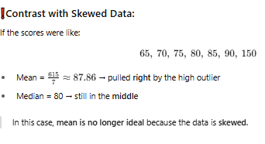
An example that shows why mean is best for symmetrical distributions:

Slide 23
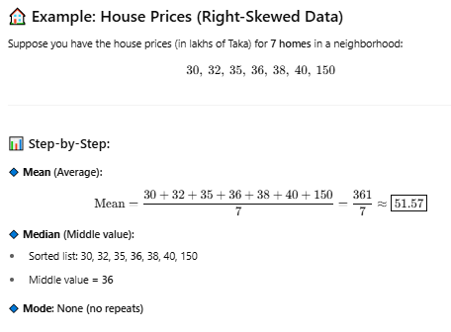
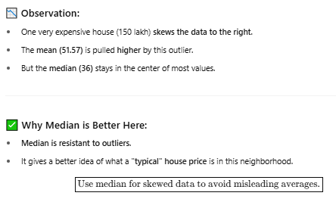
Median is best for skewed distributions, with a clear real-life example

Slide 24
Median is best for skewed distributions, with a clear real-life example
Real-Life Situations Where Median is Preferred:
  Income levels
  Real estate prices
  Hospital stay lengths
  Test scores with outliers

Slide 25
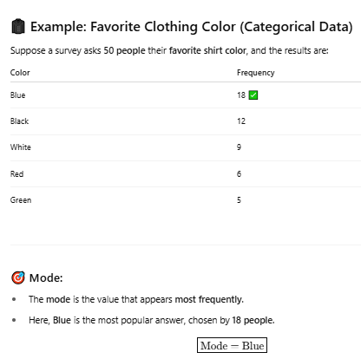
mode is best suited for categorical data, with a simple real-life example.
Why Mode Works Best for Categorical Data:
  Mean or median cannot be calculated for non-numeric (categorical) data like "Blue" or "Red".
  But mode tells us the most common or popular category.

Slide 26
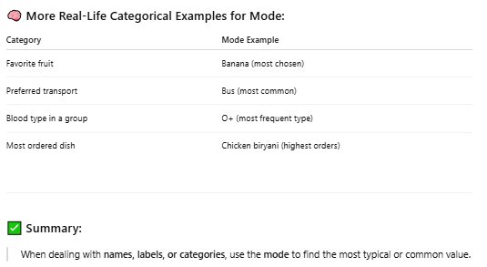
mode is best suited for categorical data, with a simple real-life example.

Slide 27
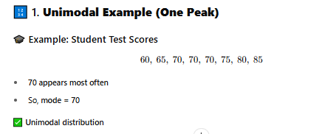
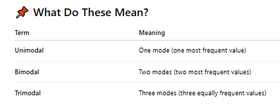
Unimodal, bimodal, trimodal real example

Slide 28
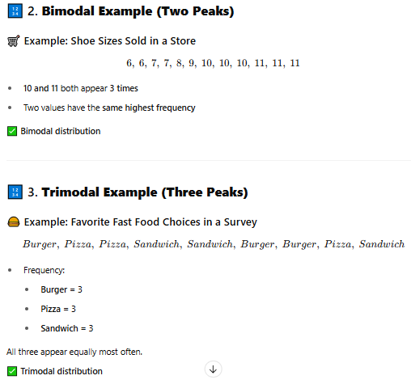
Unimodal, bimodal, trimodal real example

Slide 29
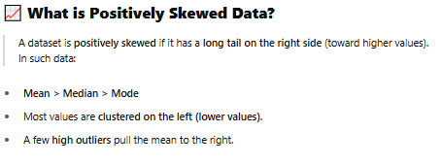
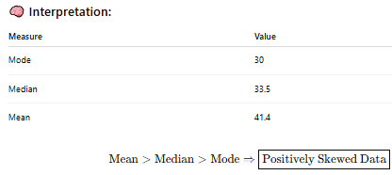
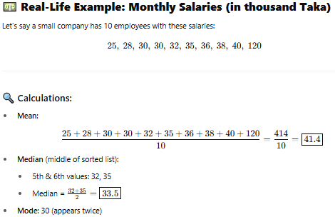
Positively skewed data example
Also called right-skewed data

Slide 30
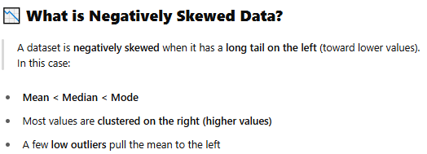
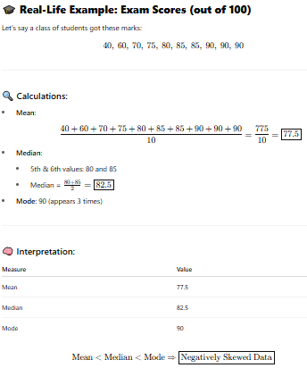
negative skewed data example
also called left-skewed data.

Slide 31



Symmetric vs. Skewed Data
Median, mean and mode of symmetric, positively and negatively skewed data
symmetric
positively skewed
negatively skewed
Data Mining: Concepts and Techniques

Slide 32
Measuring the Dispersion of Data
Range, Quartiles, and Interquartile Range
Let x₁,x₂, : : : ,x_{N} be a set of observations for some numeric attribute, X.
  The range of the set is the difference between the largest (max()) and smallest (min()) values.
Suppose that the data for attribute X are sorted in increasing numeric order.
Imagine that we can pick certain data points so as to split the data distribution into equal-size consecutive sets, as in Figure 2.2.
  These data points are called quantiles.
  Quantiles are points taken at regular intervals of a data distribution

Slide 33
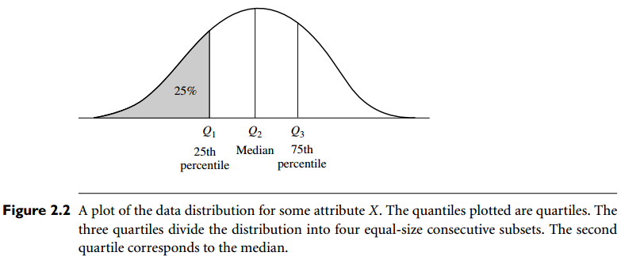
Measuring the Dispersion of Data

Slide 34
Measuring the Dispersion of Data
The 2-quantile is the data point dividing the lower and upper halves of the data distribution.
  It corresponds to the median.
The 4-quantiles are the three data points that split the data distribution into four equal parts; each part represents one-fourth of the data distribution.
  They are more commonly referred to as quartiles.
The 100-quantiles are more commonly referred to as percentiles; they divide the data distribution into 100 equal-sized consecutive sets.
The median, quartiles, and percentiles are the most widely used forms of quantiles.

Slide 35
Measuring the Dispersion of Data
The quartiles give an indication of a distribution’s center, spread, and shape.
The first quartile, denoted by Q₁, is the 25th percentile.
  It cuts off the lowest 25% of the data.
The third quartile, denoted by Q₃, is the 75th percentile—
  it cuts off the lowest 75% (or highest 25%) of the data.
The second quartile is the 50th percentile.
  As the median, it gives the center of the data distribution.
The distance between the first and third quartiles is a simple measure of spread that gives the range covered by the middle half of the data.
This distance is called the interquartile range (IQR) and is defined as IQR = Q₃ -Q₁.

Slide 36
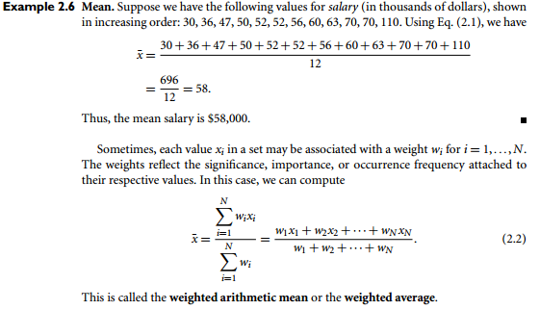
Interquartile range (IQR)

Slide 37
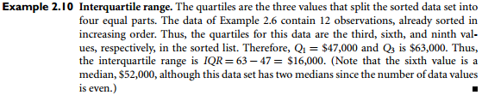
Interquartile range (IQR)

Slide 38
Measuring the Dispersion of Data (Five-Number Summary, Boxplots, and Outliers)
A common rule of thumb for identifying suspected outliers is to single out values falling at least 1.5 IQR above the third quartile or below the first quartile.
The five-number summary of a distribution consists of the
  median (Q2),
  the quartiles Q1 and
  Q3, and
  the smallest and
  largest individual observations,
written in the order of Minimum, Q1, Median, Q3, Maximum.

Slide 39
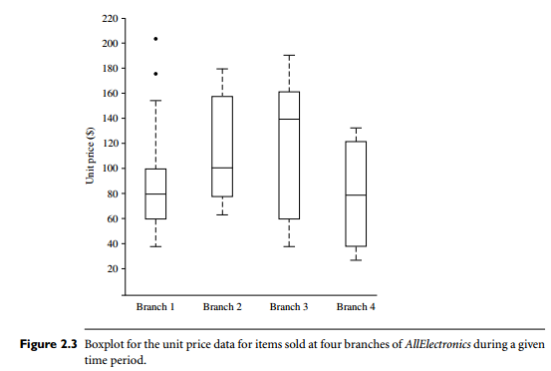
Measuring the Dispersion of Data (Five-Number Summary, Boxplots, and Outliers)
Boxplots are a popular way of visualizing a distribution.
A boxplot incorporates the five-number summary as follows:
  Typically, the ends of the box are at the quartiles so that the box length is the interquartile range.
The median is marked by a line within the box.
Two lines (called whiskers) outside the box extend to the smallest (Minimum) and largest (Maximum) observations.

Slide 40
Measuring the Dispersion of Data (Variance and Standard Deviation)
Variance and standard deviation are measures of data dispersion- scattering.
They indicate how spread out a data distribution is.
A low standard deviation means that the data observations tend to be very close to the mean,
  while a high standard deviation indicates that the data are spread out over a large range of values.

Slide 41
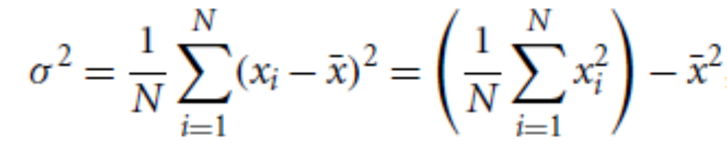
Measuring the Dispersion of Data (Variance and Standard Deviation)
The variance of N observations, x1,x2, : : : ,xN, for a numeric attribute X is
where x bar is the mean value of the observations
The standard deviation, δ, of the observations is the square root of the variance, δ²

Slide 42
Chapter 2: Getting to Know Your Data
Data Objects and Attribute Types
Basic Statistical Descriptions of Data
Measuring Data Similarity and Dissimilarity
Summary

